Slide 1
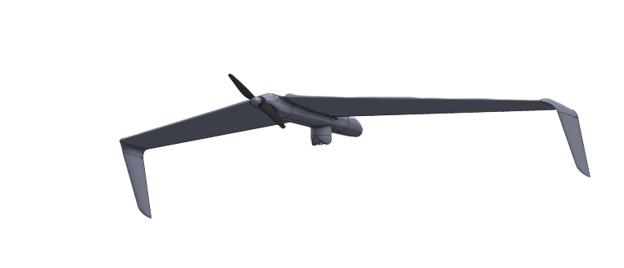
HAWK SUAV
Tactical unmanned aerial system for ISTAR missions

Slide 2
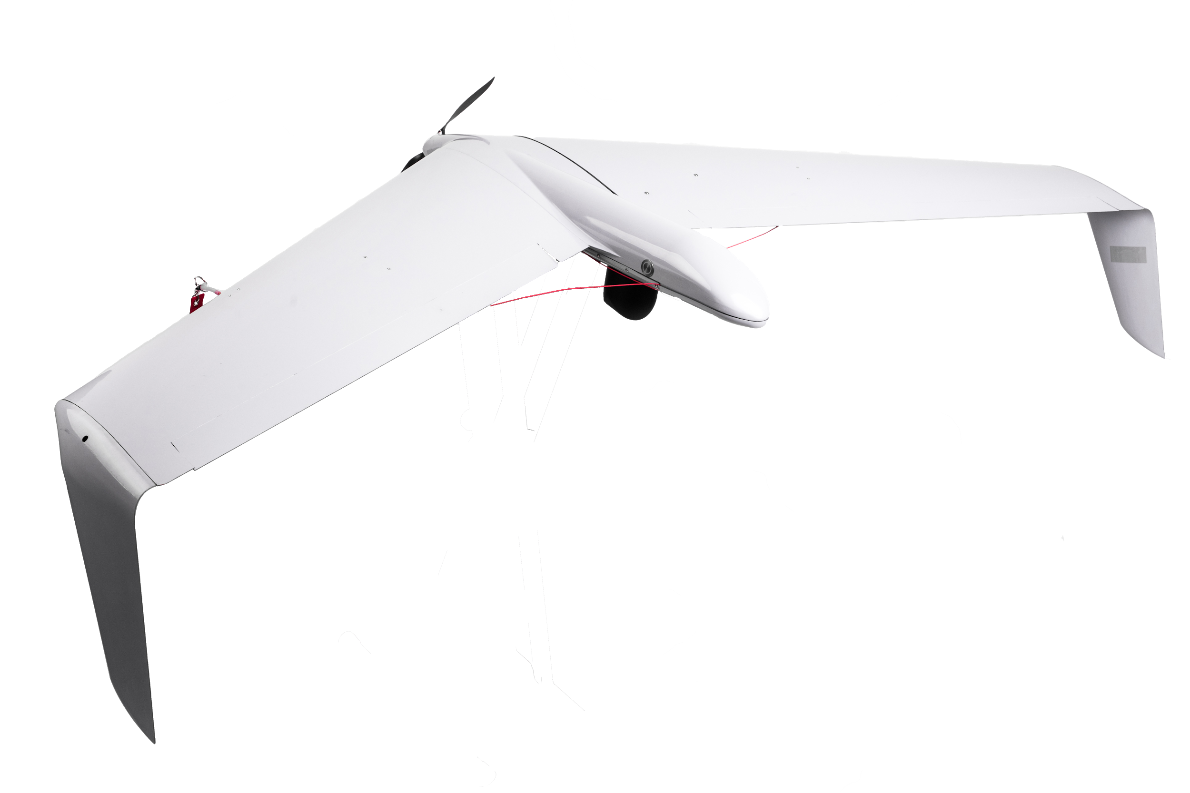
HAWK system is an innovative UAV for short-range surveillance and reconnaissance missions required for civil and military applications. A single operator is capable of carrying – deploying and operating the system.
The UAV is equipped with a silent electric motor that allows it to fly close to the mission site while remaining undetected. Its innovative design manufactured completely from aerospace grade composite materials guarantees high rigidity of the airframe that lets the operator to land the AV on rough surfaces multiple times and complete missions in extreme weather conditions.
HAWK can be equipped with various payload options that offer exquisite picture quality and stabilization. Additionally you get features like target tracking and thermal imaginary. The list of advantages continues with is its cutting-edge, developed in-house, autopilot capabilities that grant the operator a safe, fully automated flight, allowing him to remain mission focused.

Slide 3
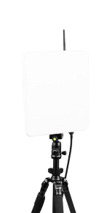
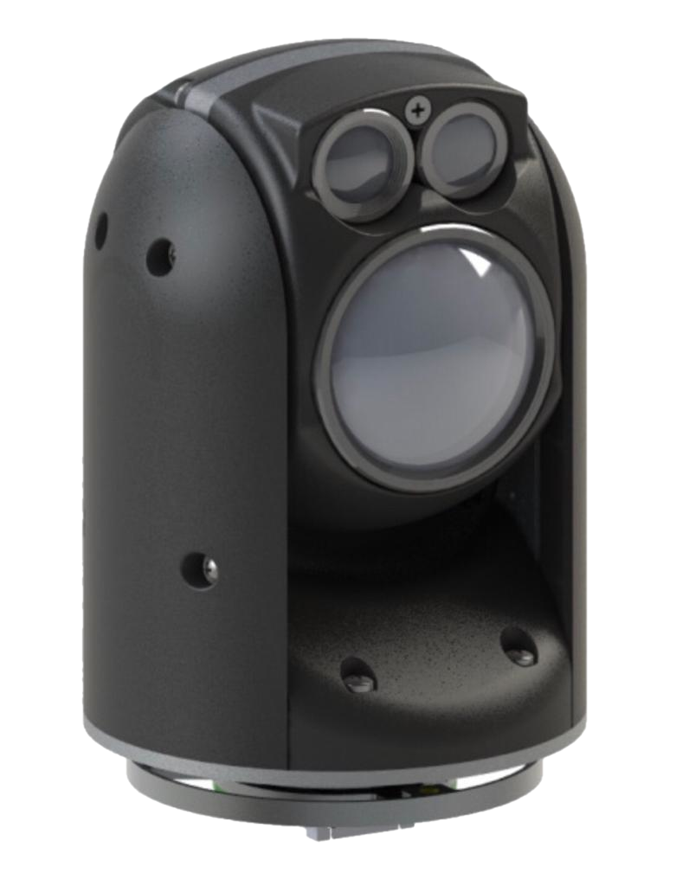
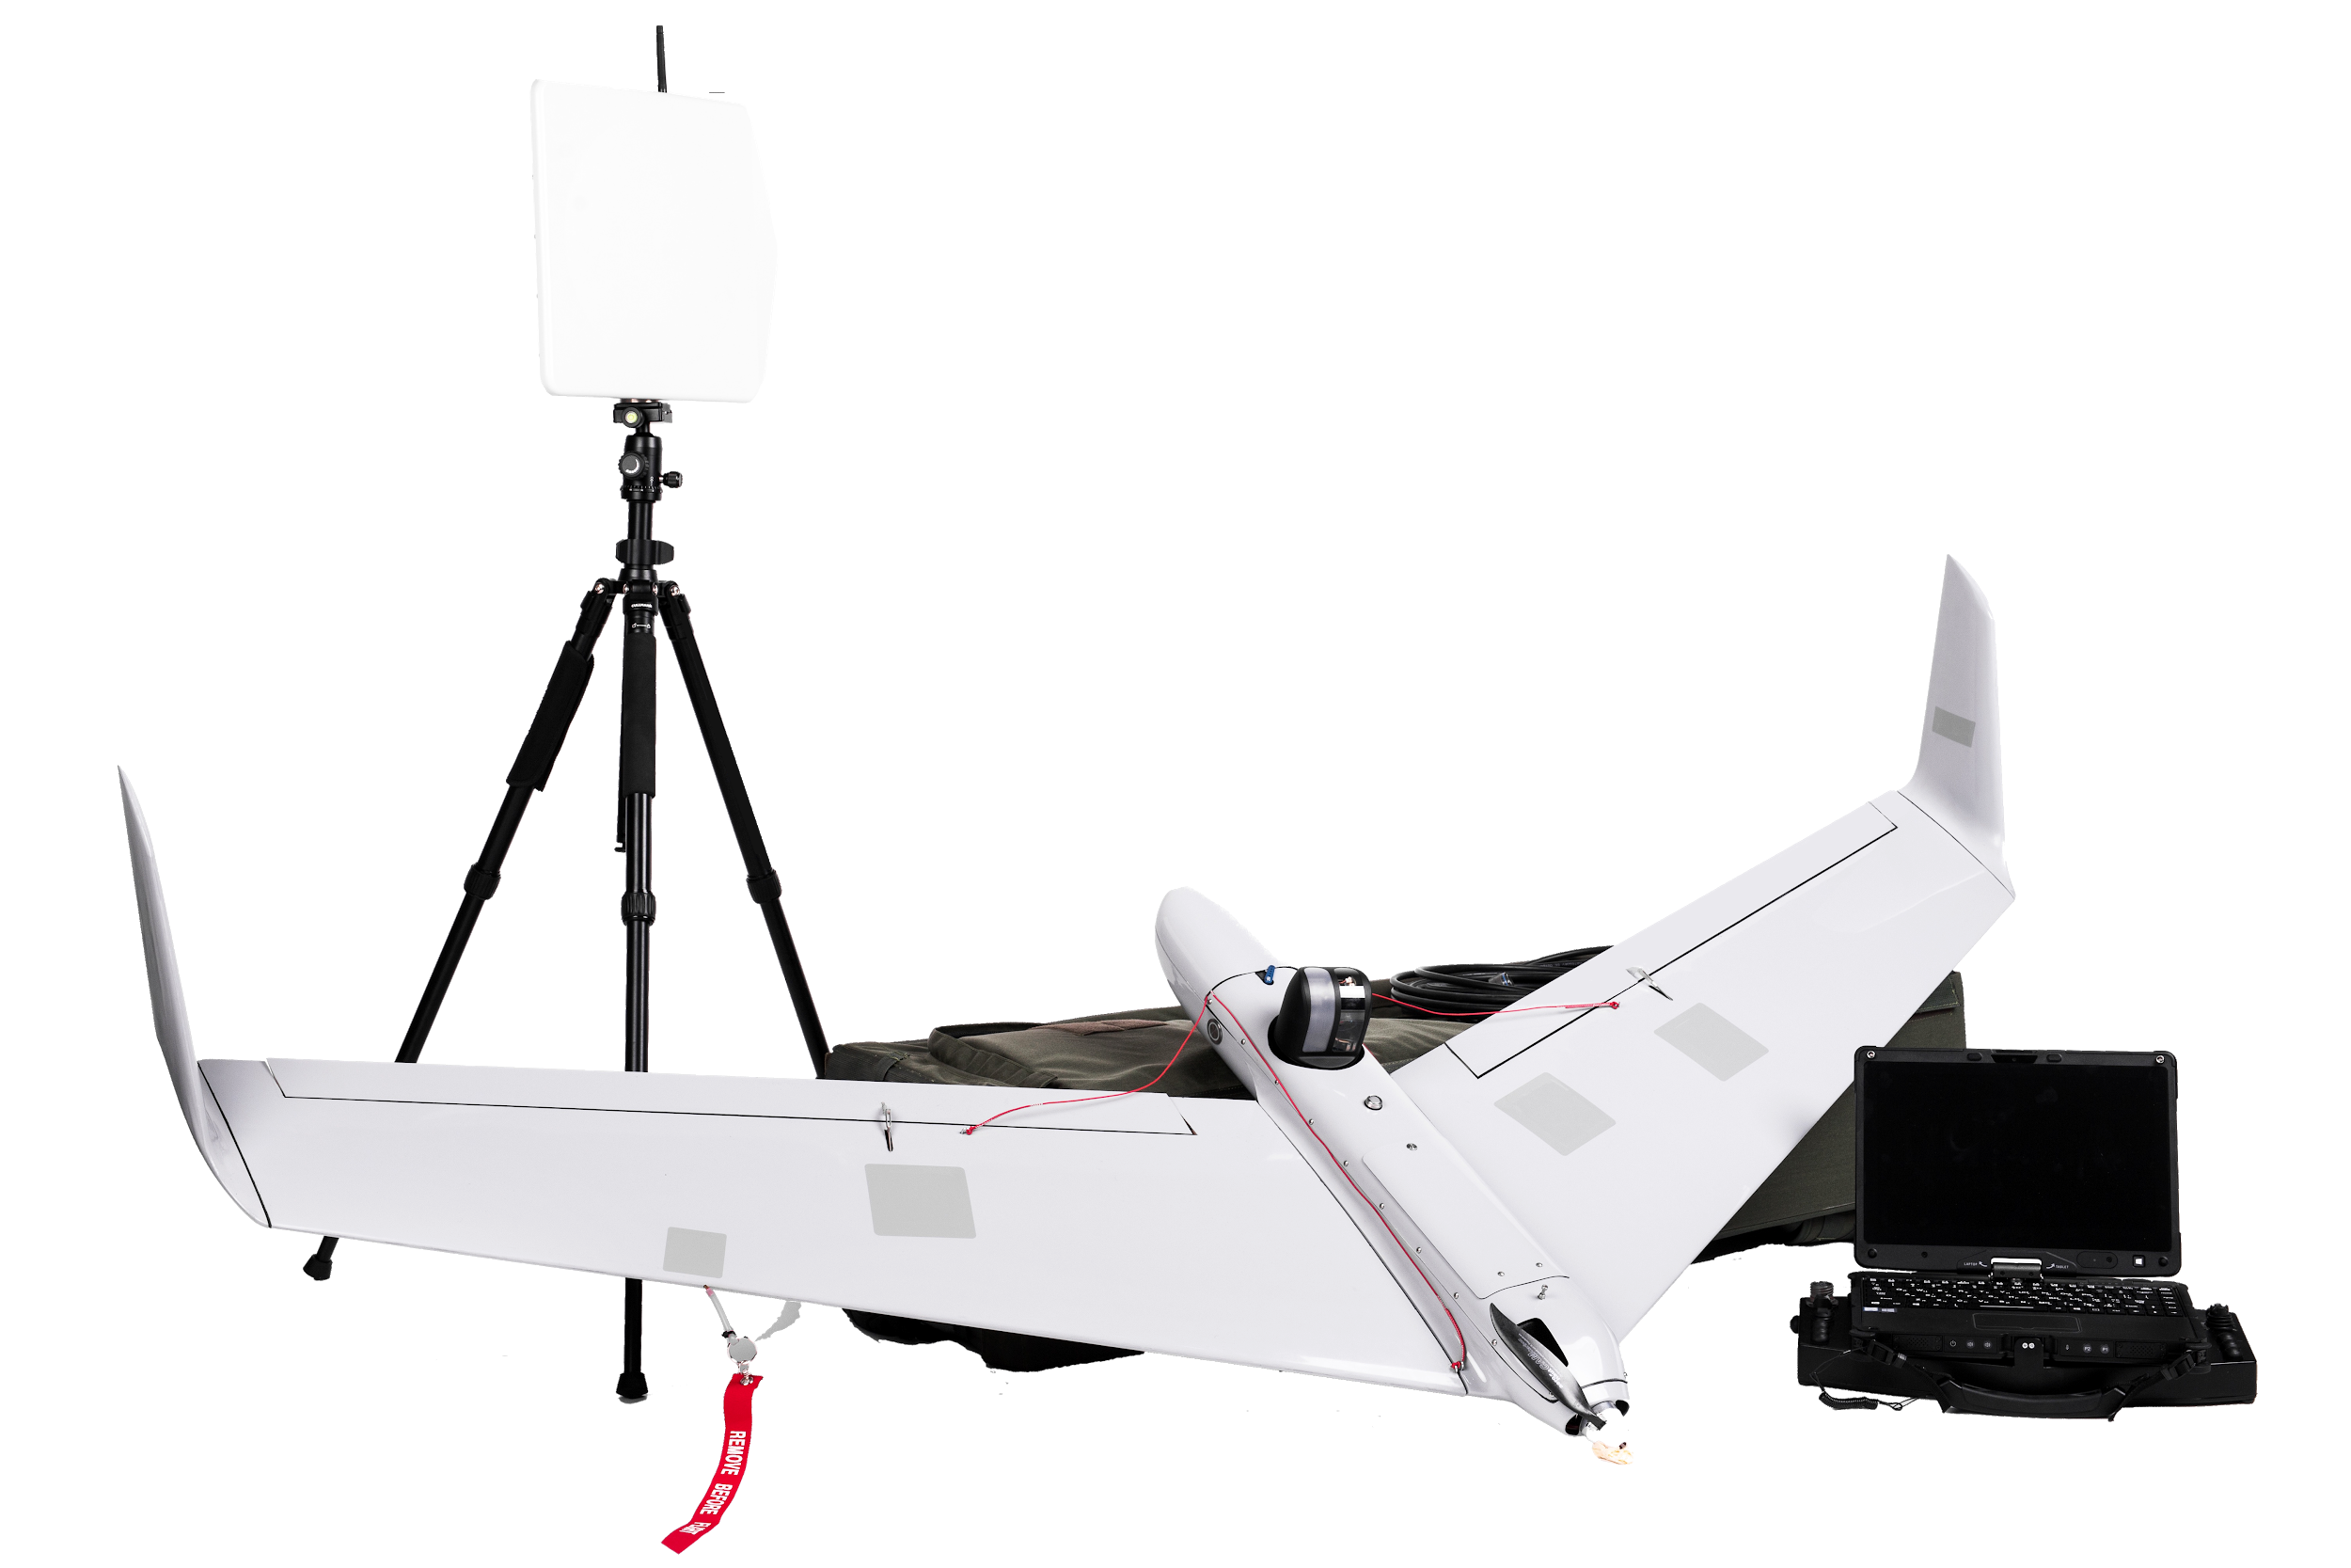
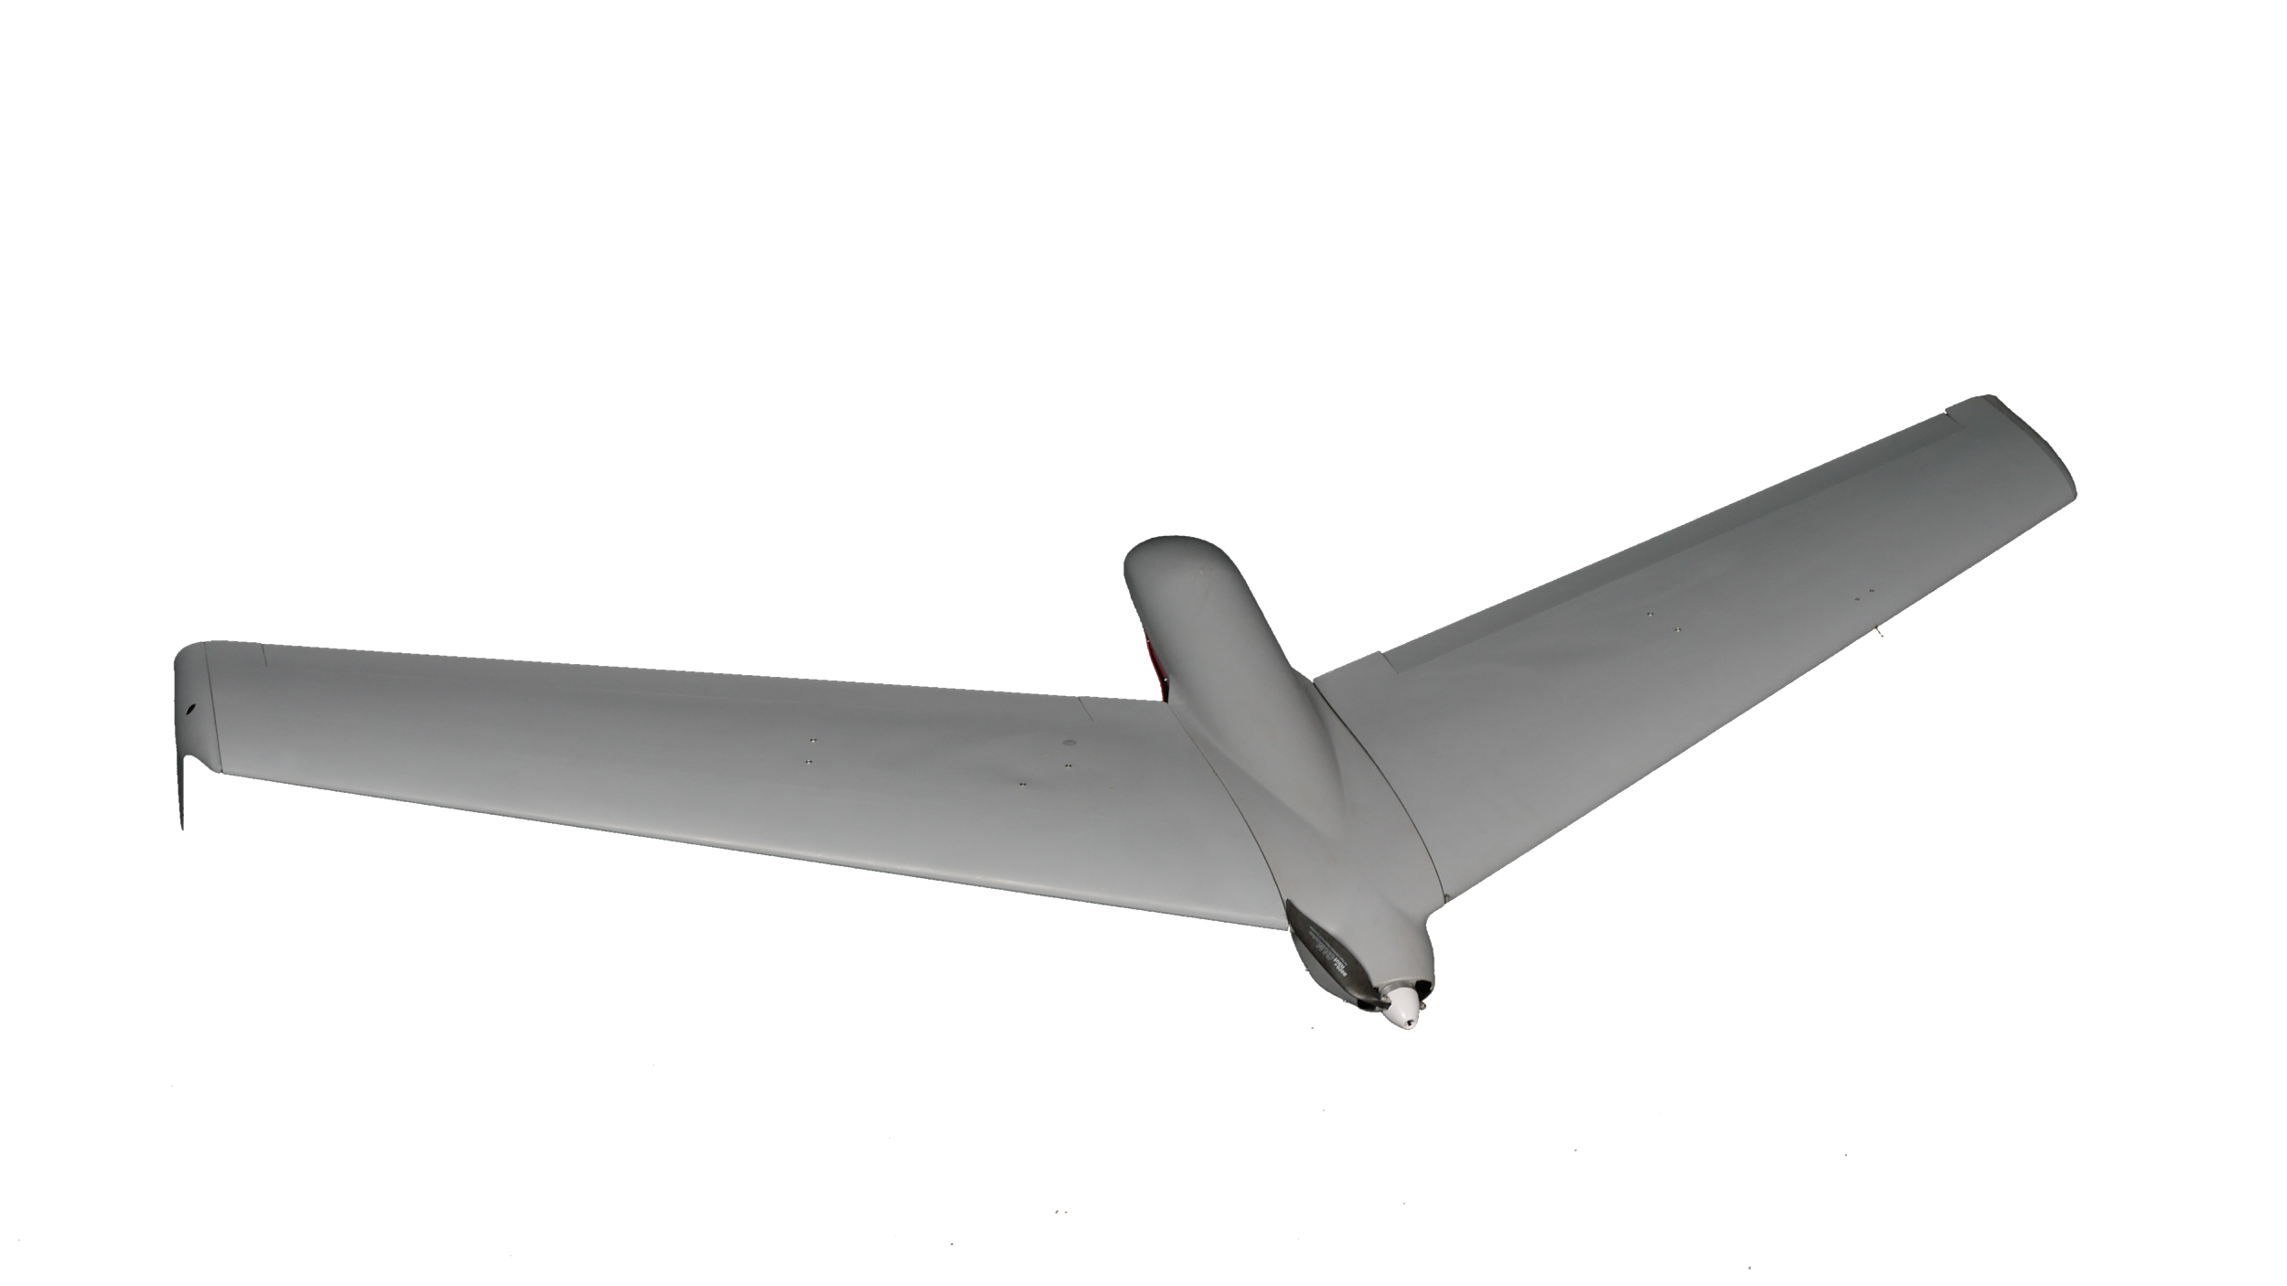
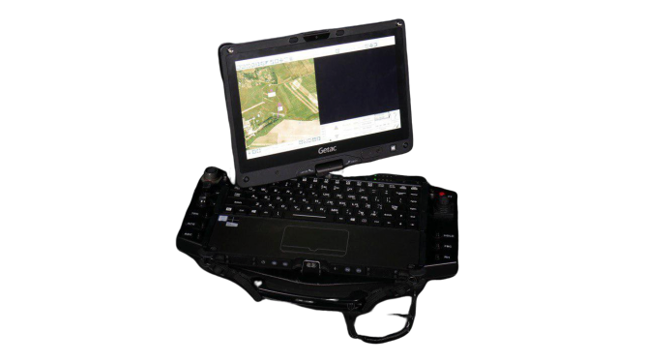
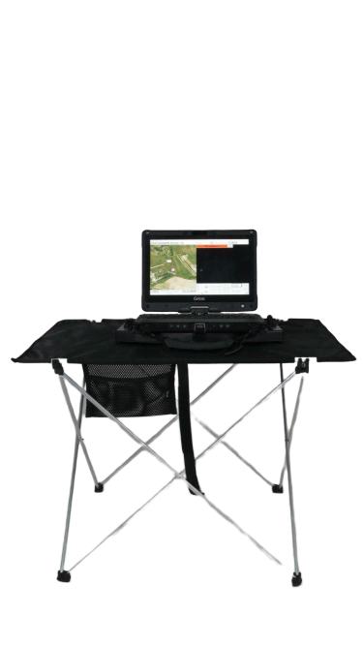
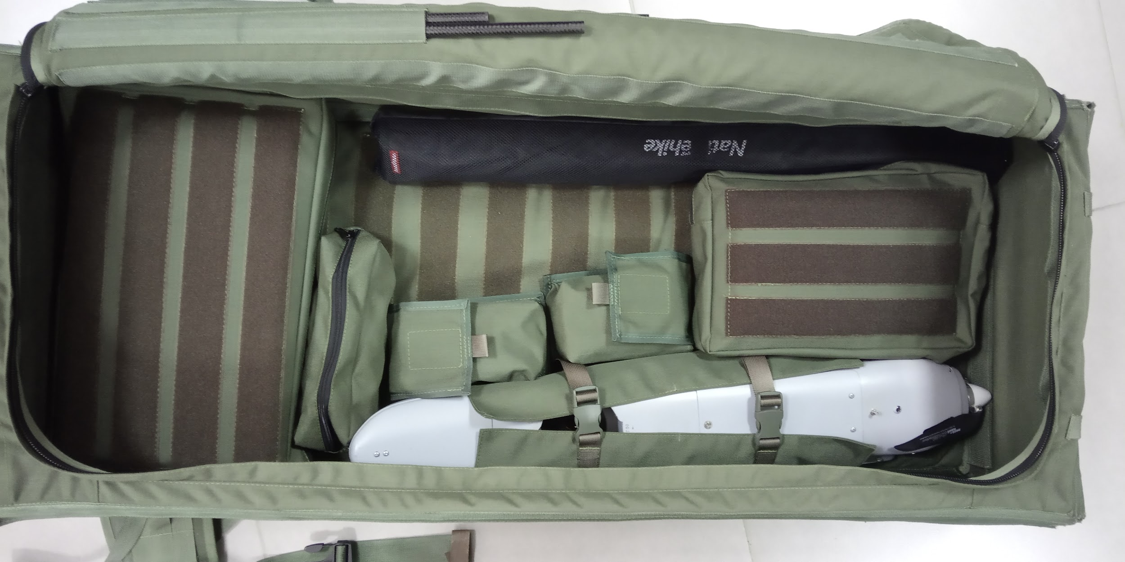
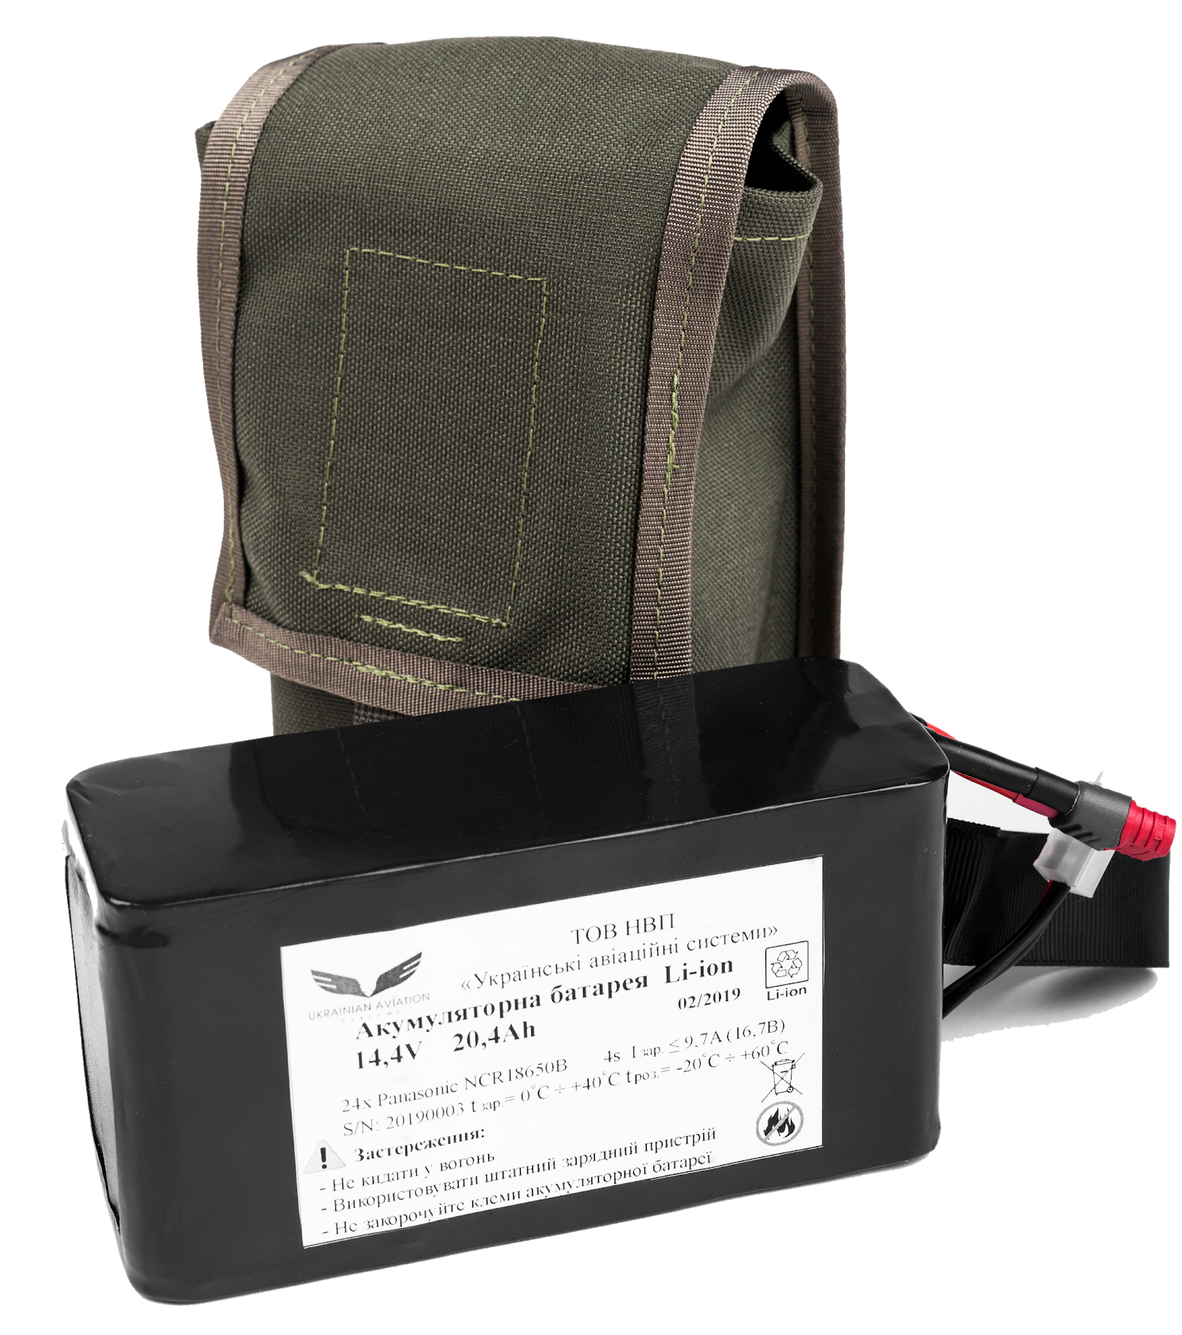
Ground Data Terminal with automatic dual axis tracking - GDT
Payload - EO/IR stabilized gimbal embedded with target tracking
Airframe
Multifunctional Rugged Ground Control Station - GCS
Spares and Tools
GDT
Launcher
Comfort Kit
Set of Li-ION batteries
Transportation backpack

Slide 4
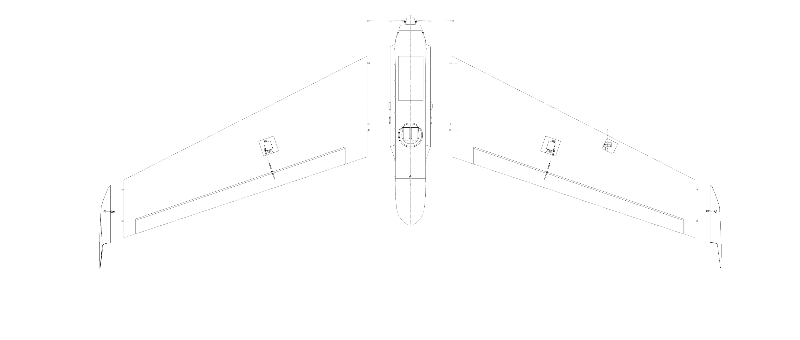
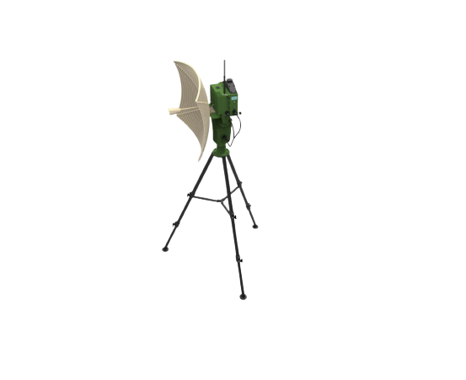
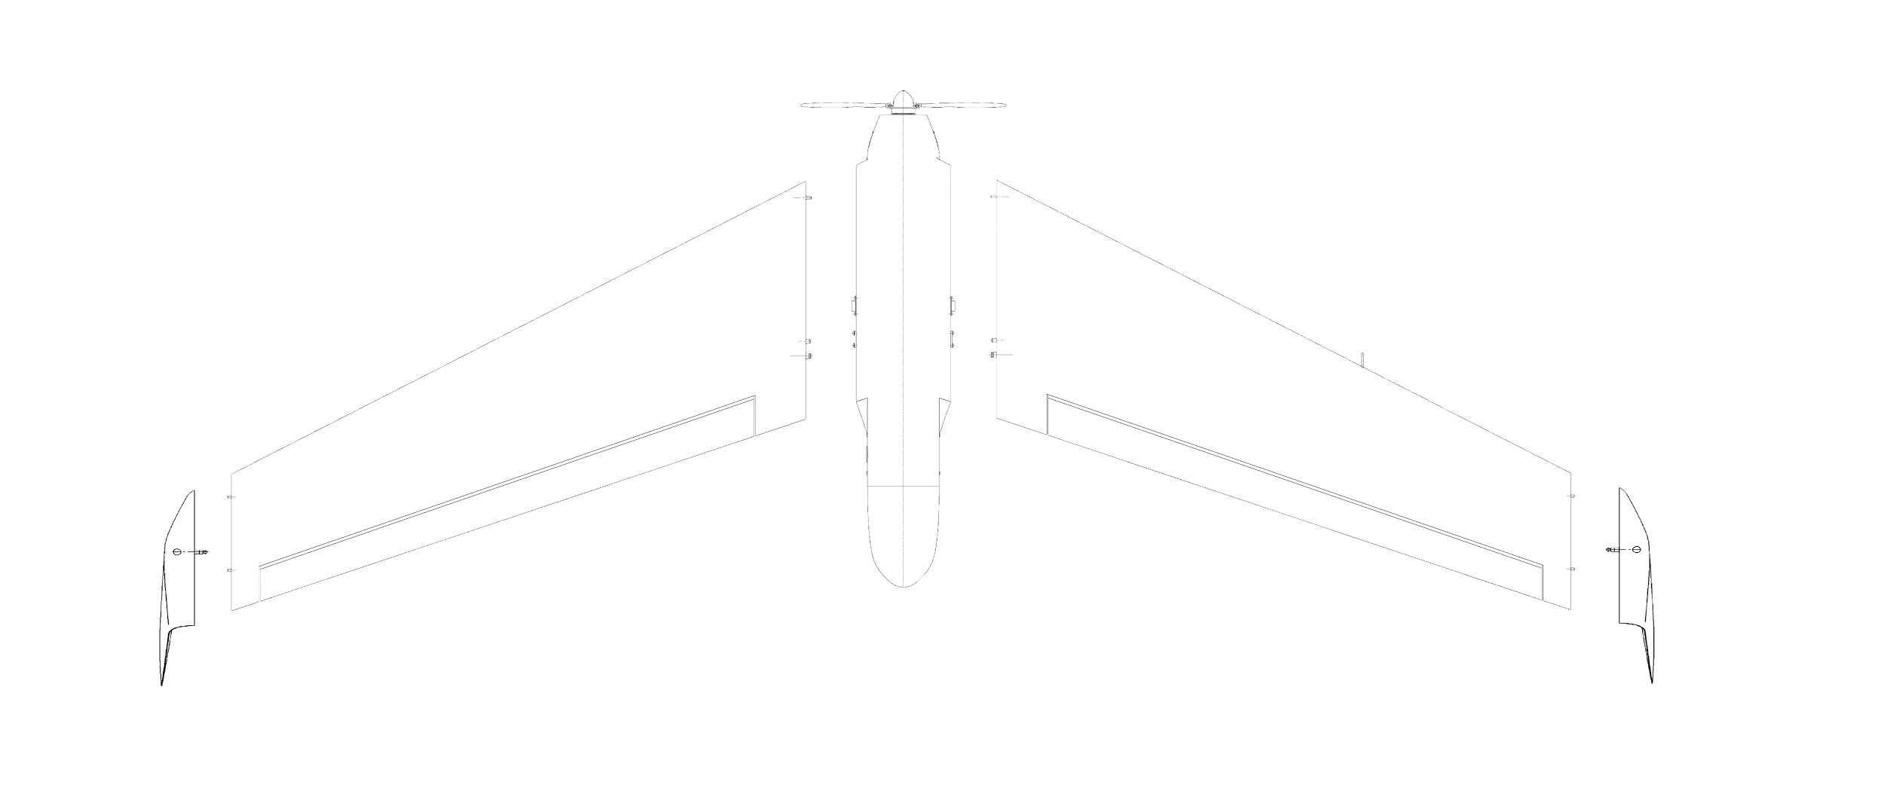
UAV Specifications
Max take off weight...........................5,5 kg
Payload weight...........................up to 1 kg
Wingspan............................................2 m
Endurance...................................up to 4 hr
Effective Range........................up to 60 km
Maximum Altitude...................1200 m AGL
Max Take off Altitude...............4000 m ASL
Time to deploy.......................under 10 min
Navigation systems....................GNSS, INS
Wind.......................................up to 15 m/s
Operational Temperature..........-30...+50 °C
Rain..........................................<20 mm/hr
Noise signature....undetectable from 100 m
Touchdown accuracy..........................20 m
Recovery - parachute landing on any surface
Aerial data terminal and Ground data terminal Specifications*
ADT - Supports P2P, P2M (Listening)
Dynamic Master / Interface through web browser
Data link encryption......AES 128 (256 optional)
Frequency...............….2.1-2.5 GHz (Adjustable)
Throughput ..............................up to 10 Mbits
FHSS .........................................up to 250 pps
Output Power ................up to 1 W (Adjustable)
GDT-60 is a dual-axis mini ground antenna data terminal, capable of positioning a directional Data-Link antenna in both azimuth and elevation axes. The GDT-60 system is a lightweight, simply deployed and provides a sufficient gain with its S-Band (2-4 GHz) or C-Band (4-8 GHz) directional antenna to support Data-Link range up to 60km, even with a low power radio.
The GDT-60 is equipped with built-in Tracking & Logic Controller (MCU) to provide progressive control modes and tracking algorithms, such as RSSI tracking, GPS pointing, Search mode and more.

Slide 5
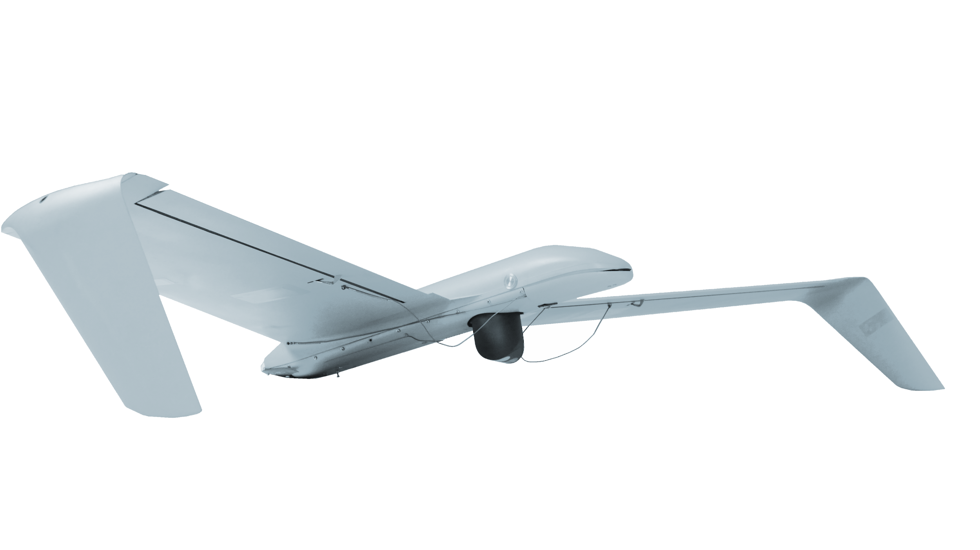
EO/IR STABILIZED GIMBAL
Smallest 3 sensor stabilized gimbal with long range continuous zoom capability
​ Visible Camera
Visibility…………......................................400-700 nm
Resolution..............................................1280x720
Zoom...........................x20 + x2 digital, (total x40)
HFOV...............- 60° WFOV – 3° NFOV – 1.5° DFOV
Delay.....................................................< 40 msec
Thermal Camera
LWIR uncooled........................................(8-12μm)
Resolution..............................................1280x720
Zoom.................. ........x4 digital, continuous zoom
HFOV...............................- 18° W.FOV - 4.5° D.FOV
Pan.....................................360° (non continuous)
Tilt.......................................................-45° to +90°
Control Interface........................................RS-232
Video Interface....................................Micro-HDM
Stabilization............................................< 70 μrad
Recommended height for IR camera....100-300 AGL
Dimensions.................................Diameter 63 mm
Height.......................................................93 mm
Weight.................................................355 grams
Temperature..................................-30°C to +55°C

Slide 6
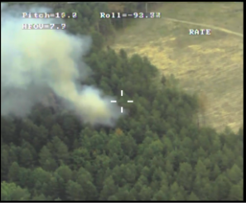
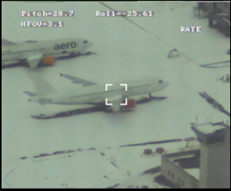
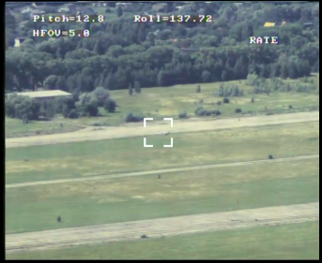
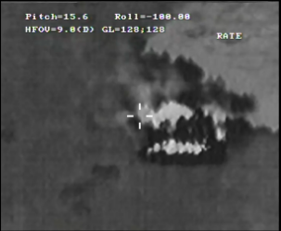
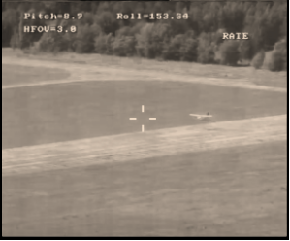
Operating multiple AVs from one GCS
Various flight modes including ATOL
In-house developed components
Real-time aerial video and photos. Moving target tracking
KEY BENEFITS
A perfectly balanced and agile AV with robust construction
Proven track record of operating in extreme temperatures from -30C to +50C
Resistance to communication jamming using FHSS
Operating in GPS spoofing and jammed areas
Effective HD thermal sensor
Touchscreen target tracking
Geo lock for stealth missions

Slide 7
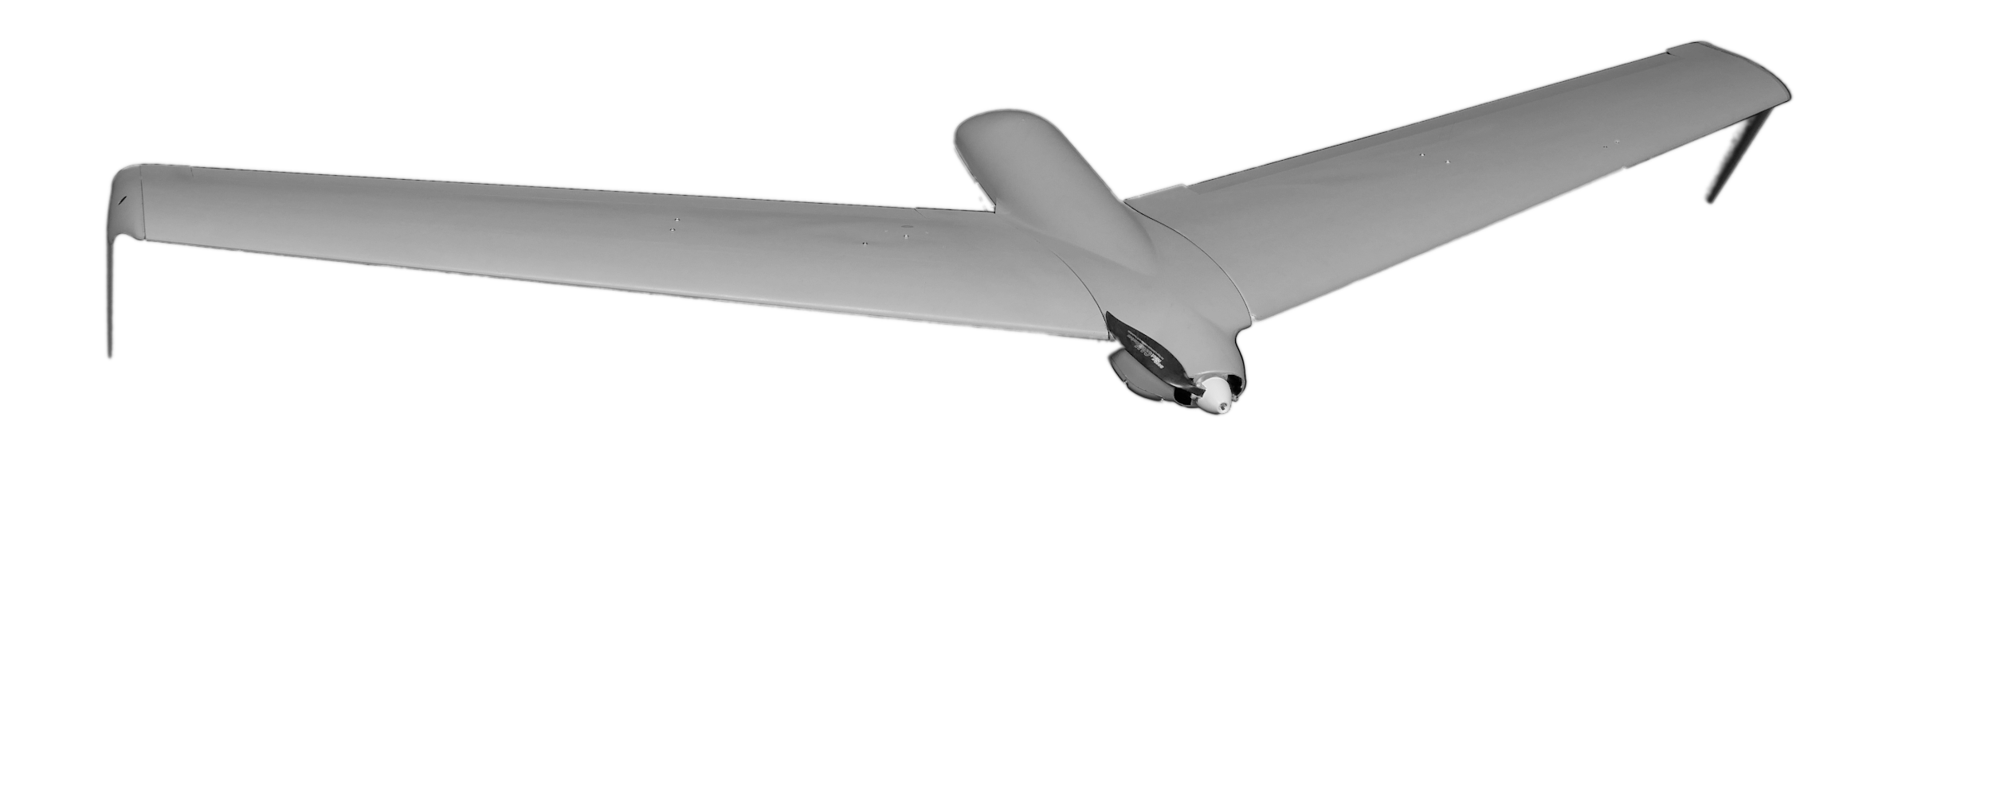
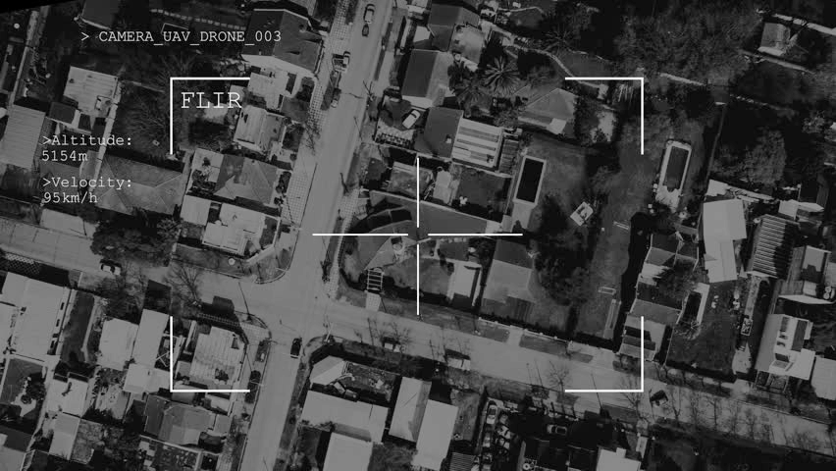
Applications
Military
Civilian
Commercial​
Security monitoring:
power lines
oil and gas pipelines
industrial facilities
railway stations
agriculture
Search and rescue missions
Intelligence gathering
Close combat missions
Target acquisition
Mission support
State border security
Emergencies
Forest fires, floods and oil spills detection
Emergencies forecasting and prevention
Illegal logging and poaching prevention

Slide 8
Spare parts list | GSE list
Motor 2 ESC 1 Servo 3 Propeller 5 Wing joiner 10 Parachute 1 Bungee Launcher 1 | Charger 1 Backpack 2 Shipment case 1 Batteries 4 Transportation case 1 Field repair kit 1 Set of tools 1 Bungee Launcher 1
The budgetary price for various buy options are as follows:
Price of system on quantity of 6 with 3 AVs per system = 450.000 EUR
Training course in country : Included in the price. (Traveling and lodging expenses are covered by customer). Training course is performed on customers systems. 2 weeks operation and maintenance training for 4 operators.
First 2 systems within 4-5-months ARO
Payment terms
65 % down payment for the all delivery
35 % upon shipment documents

